Slide 1
International Science Landscape
First Orientation & Useful Tips #1: Sweden

Slide 2
Agenda
Who am I?
What do I know about being a scientist in Sweden?
Questions & Answers

Slide 3
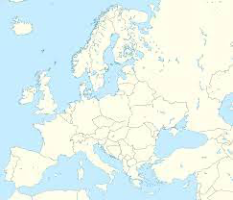
My path

Slide 4
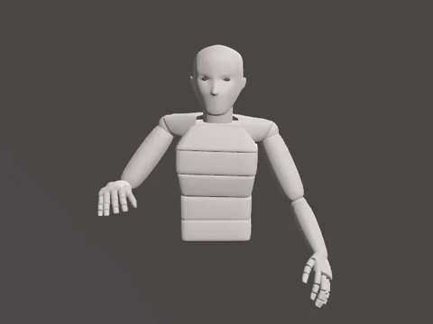
My education
Bachelor
Master
PhD
Applied Mathematics
Kyiv Polytechnic Institute
Kyiv, Ukraine
Machine Learning
RWTH Aachen University
Aachen, NRW, Germany
Deep learning for animation
KTH Royal Institute of Technology
Stockholm, Sweden

Slide 5
Agenda
Who am I?
What do I know about being a scientist in Sweden?
Questions & Answers

Slide 6
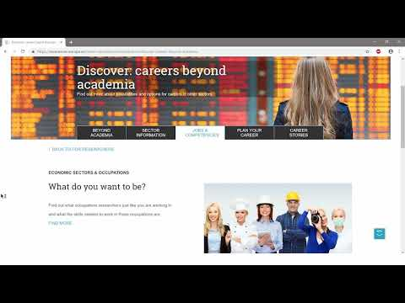

Slide 7
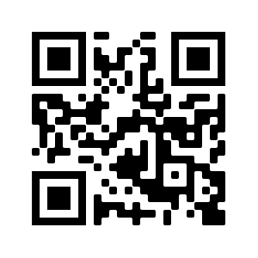
Where to find more information?
https://www.euraxess.se/

Slide 8
Questions & Answers

Slide 9
My research

