Slide 1
Prof. Dr. Maksym Yarema
Chemistry and Materials Design Group Institute for Electronics
ETH Zurich
www.cmd.ethz.ch
yaremam@ethz.ch
Swiss Science Landscape:
First Orientation and Useful Tips
Where to apply?
What to offer?

Slide 2
Swiss science landscape
Research and education institutions
Funding organization
Two approaches to secure an academic position in Switzerland
Notes:
Educational programs are not discussed here.

Slide 3
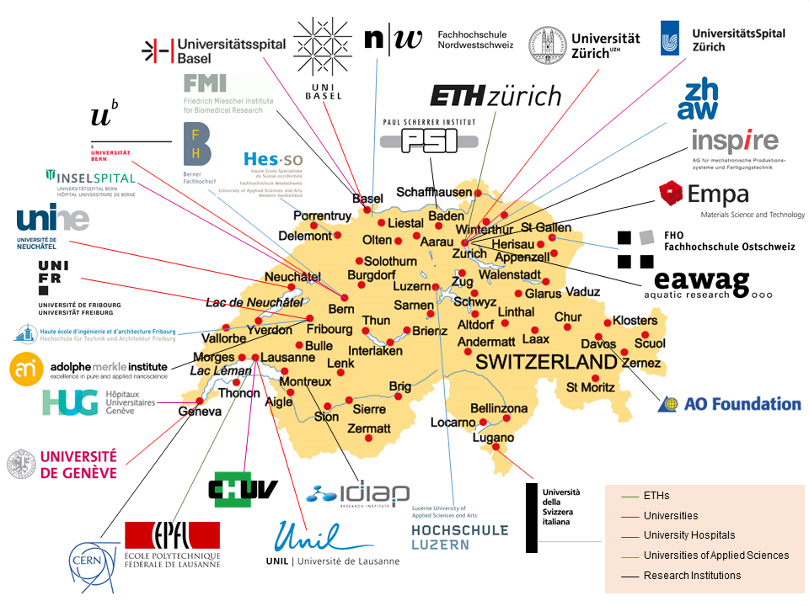
Research and education institutions in Switzerland

Slide 4
Overview of funding organizations
Swiss National Science Foundation, SNSF (general calls, mobility, career tools)
Innosuisse, Swiss Innovation Agency (industry-oriented projects, startups, ptototypes)
Government, other federal offices (e.g., Swiss Government Excellence Scholarships)
Internal University funds (e.g., ETH Zurich Postdocs, Master scholarships)
Big companies
EU funding
Foundations (Gebert Ruef, Esther, Swiss Re, Helmut Horten, KMPG, ...)

Slide 5
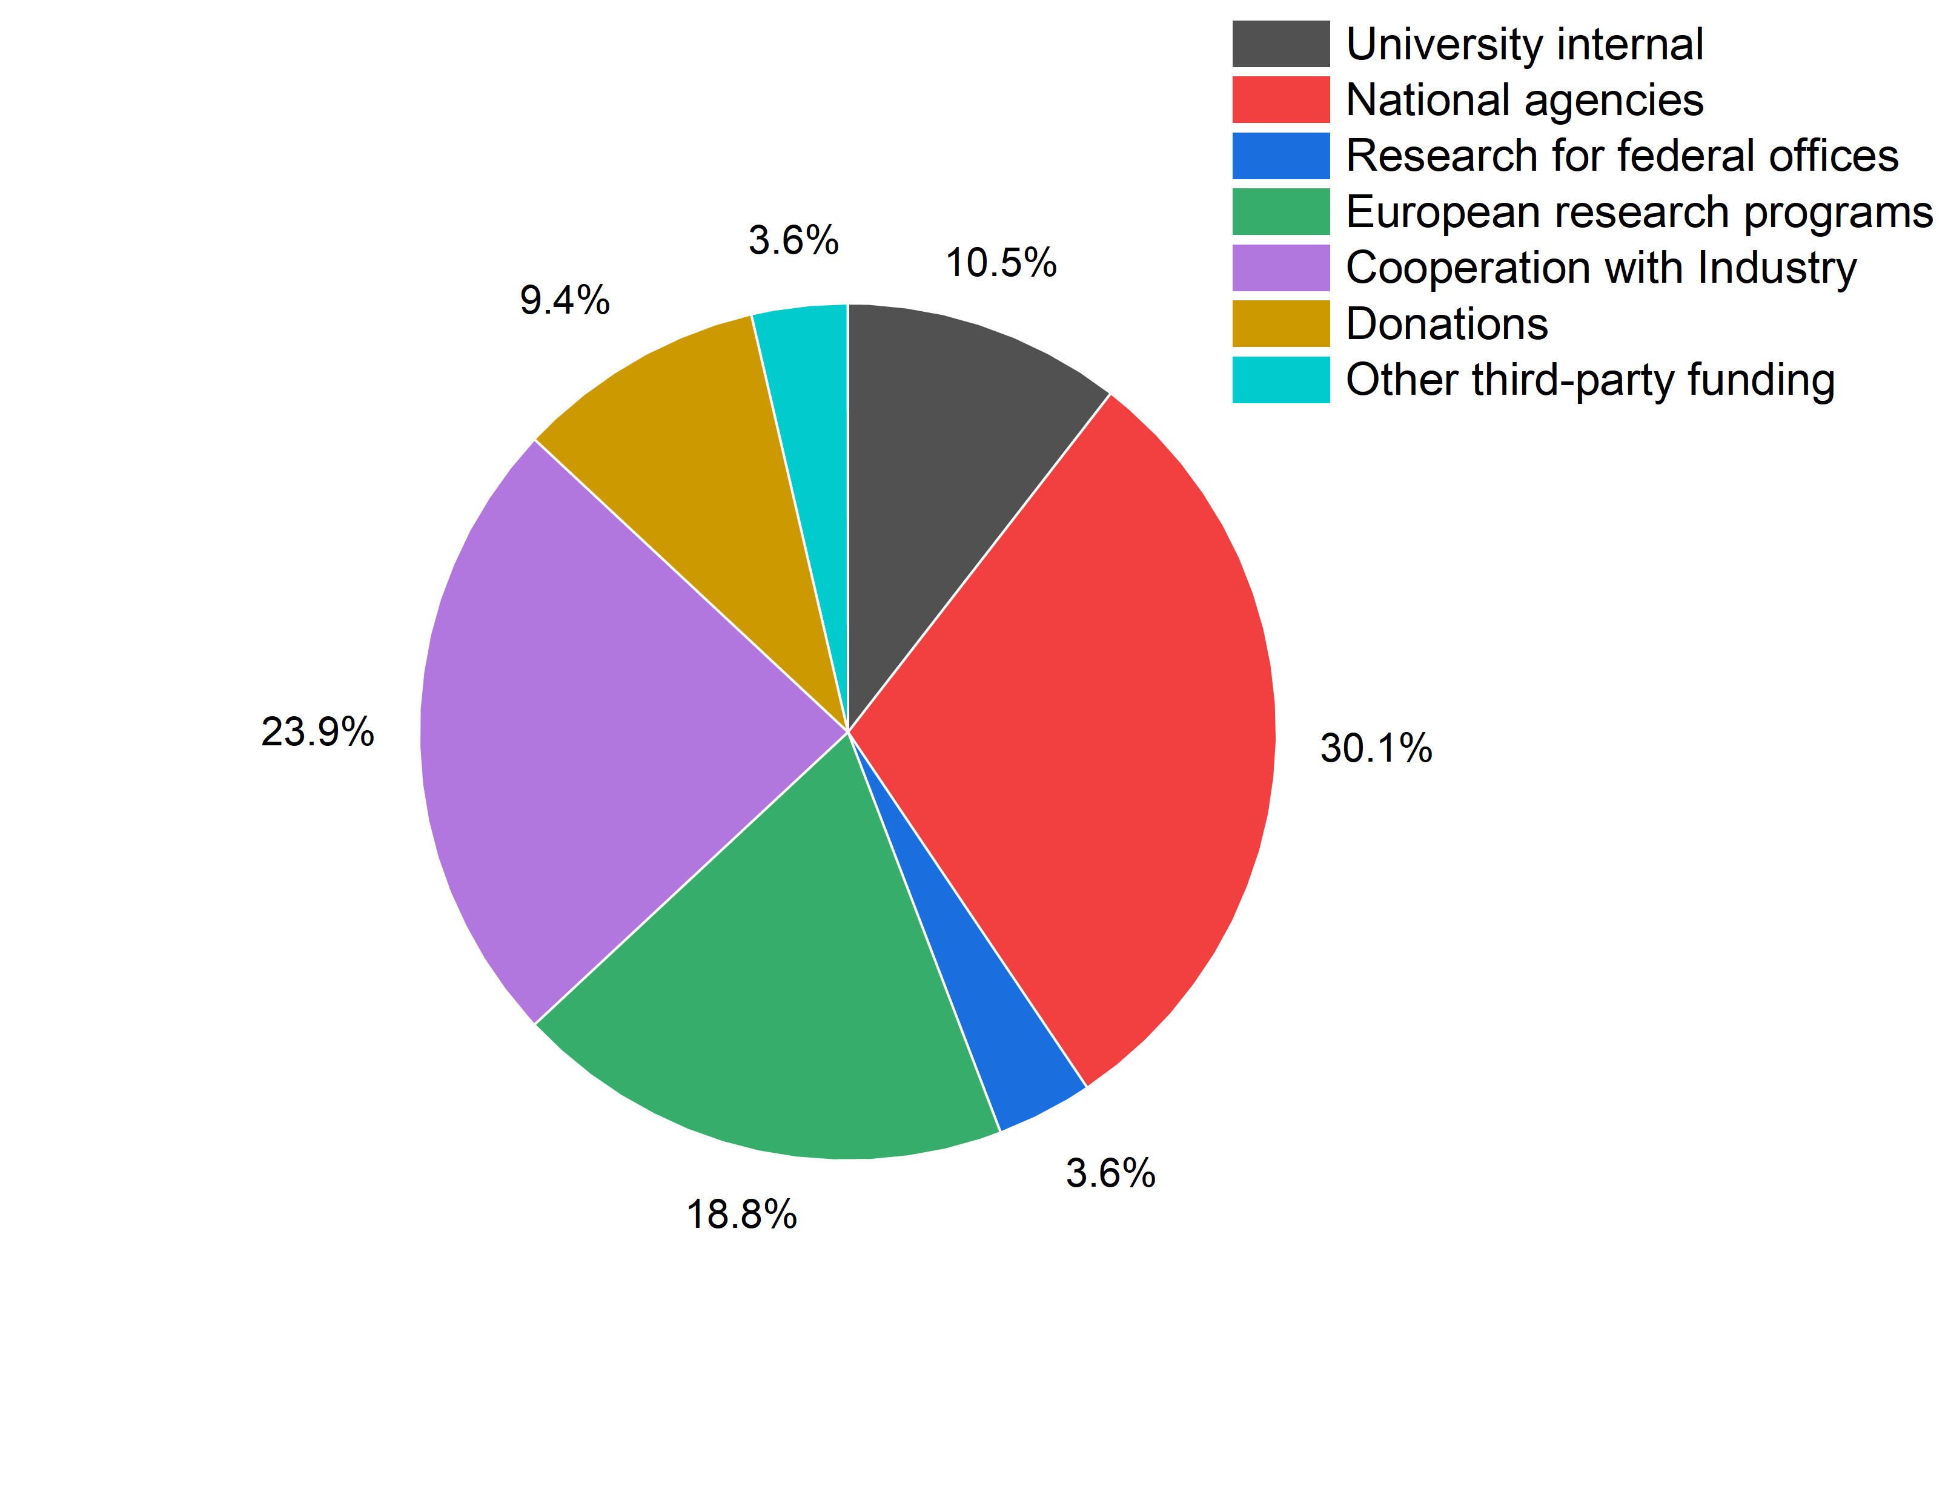
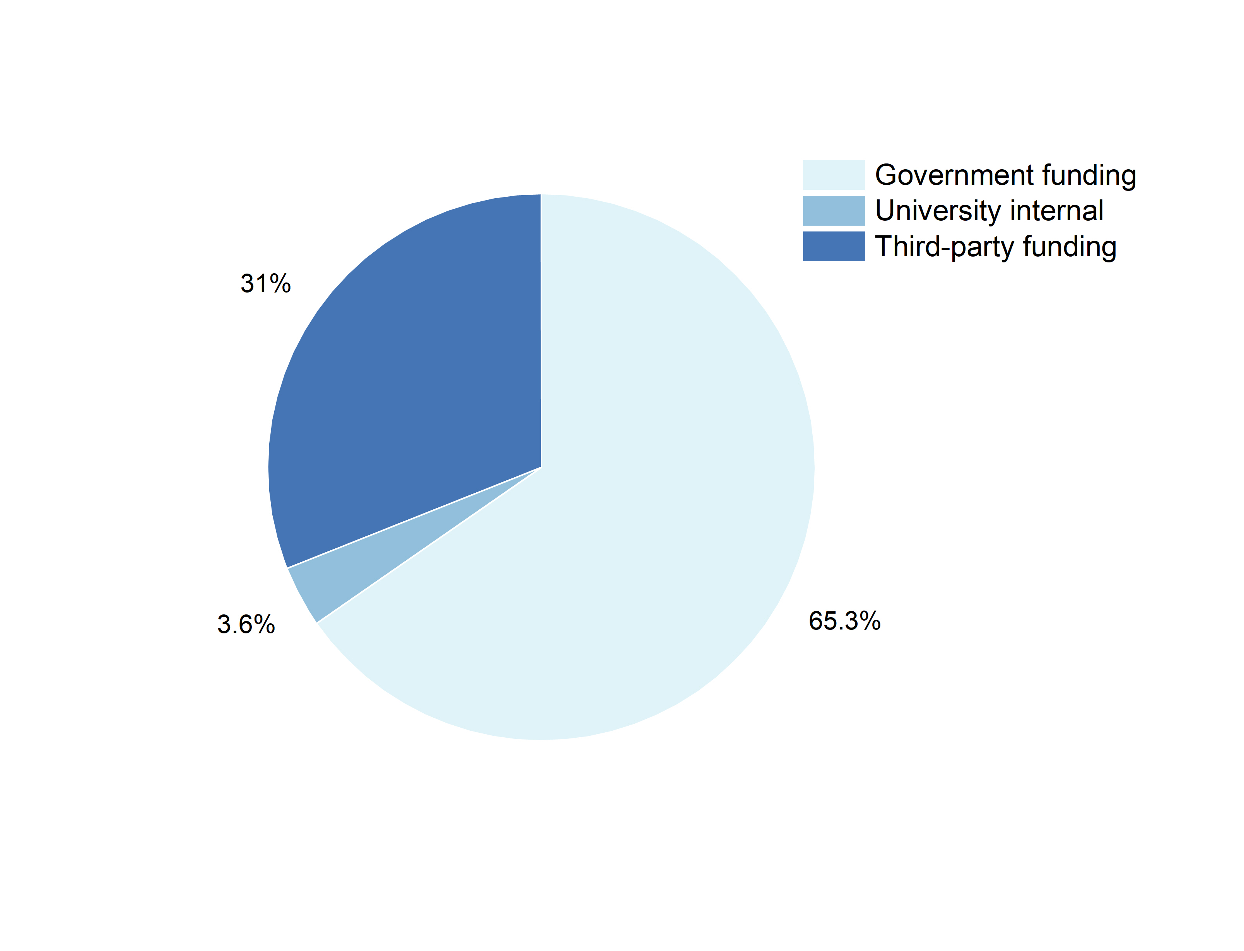
Example of funds distribution
Competitive funding

Slide 6
How to secure an academic position in Switzerland?
Direct hiring
Find an open position
Approach professors directly
Doctoral school at EPFL
(In all cases, you will need an application package, incl. cover letter, CV, etc.)
Write your own grant
You will need to find a host
Notes:
There are two ways: direct hiring and getting a position with your own grant

Slide 7
Direct hiring: traditional way to find a job
1. Look for open positions (at segregator sites like academics.com or directly at the home pages of universities and research groups)
2. Prepare an application package (most important is cover letter, then CV, then everything else like transcripts, certificates, references)
3. Be ready with the presentation about your past research and/or future interests.
4. At the interview: be honest and positive (no defensive mode). Prepare yourself to the most common interview questions.
It is much more feasible than you think!
Notes:
There are PhD, postdoc, and technical positions. You can consider to redo a PhD.

Slide 8
Alternatively, why don’t you apply for a grant?
We won’t get it anyway
Ukrainian science is a “different” level
My topic is not trendy
We have no equipment (infrastructure) to work with
Someone will steal our ideas!
We don’t know where exactly to apply
We cannot find partners
It is embarrassing to ask for money
Our English is not sufficient
Interviews are terrifying
It doesn’t add any career opportunities (not worth it)
It takes too much time to write (waste of time)
It is a problem to come (administration of project is difficult)
I like teaching more than research
I have a second (side) job
I have (had) already one (two, three) grant(s)
I am too old / too young
Notes:
1. I don’t believe in myself
2. Ideas are super-precious
3. Technical challenges
4. Management challenges
5. Just not interested

Slide 9
Types of grants
Individual
Research projects (general call)
Programmes (topical)
Mobility grants
Career tools
Outreach and event grants
Measurements and field work grants
Award grants, scholarships
Collaborative
International collaborations and bilateral programmes
Consortia
Industrial collaborations
Networks
Teaching grants
Infrastructure grants
Notes:
+ woman-supporting funding in STEM

Slide 10
Writing a good research proposal
Checklist before you start writing
Eligibility criteria
Submission deadline(s)
Is it a good fit (scope, format, what’s funded)
Self-evaluation
Partners on board?
Specify administration routine
Make feasible writing plan

Slide 11
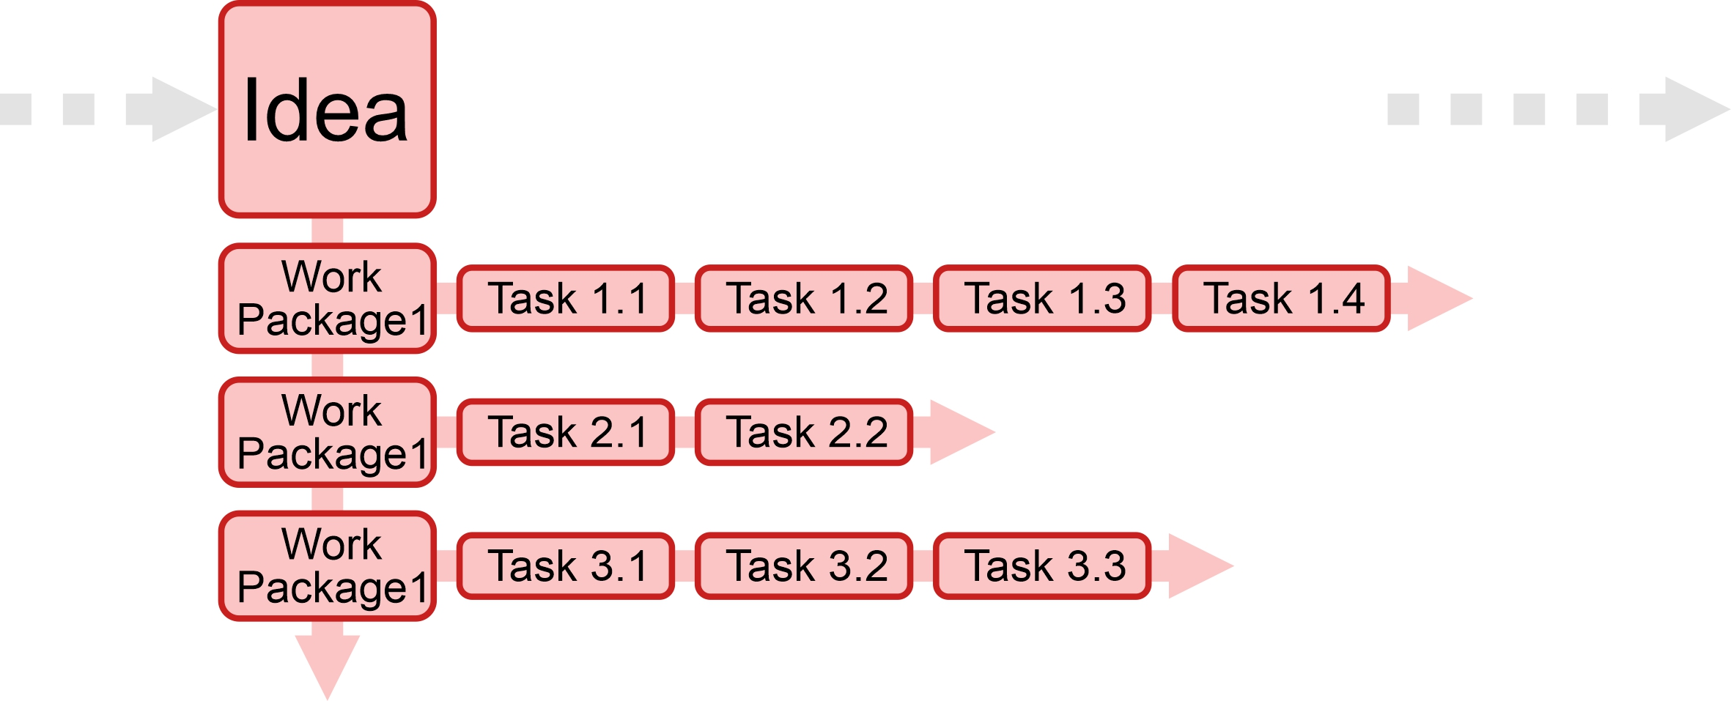
Writing a good research proposal
Start from idea / concept
Give it a depth (splitting into doable tasks)
Give it a structure (add timeline)
Give it a perspective (Why relevant? Why timely?)

Slide 12
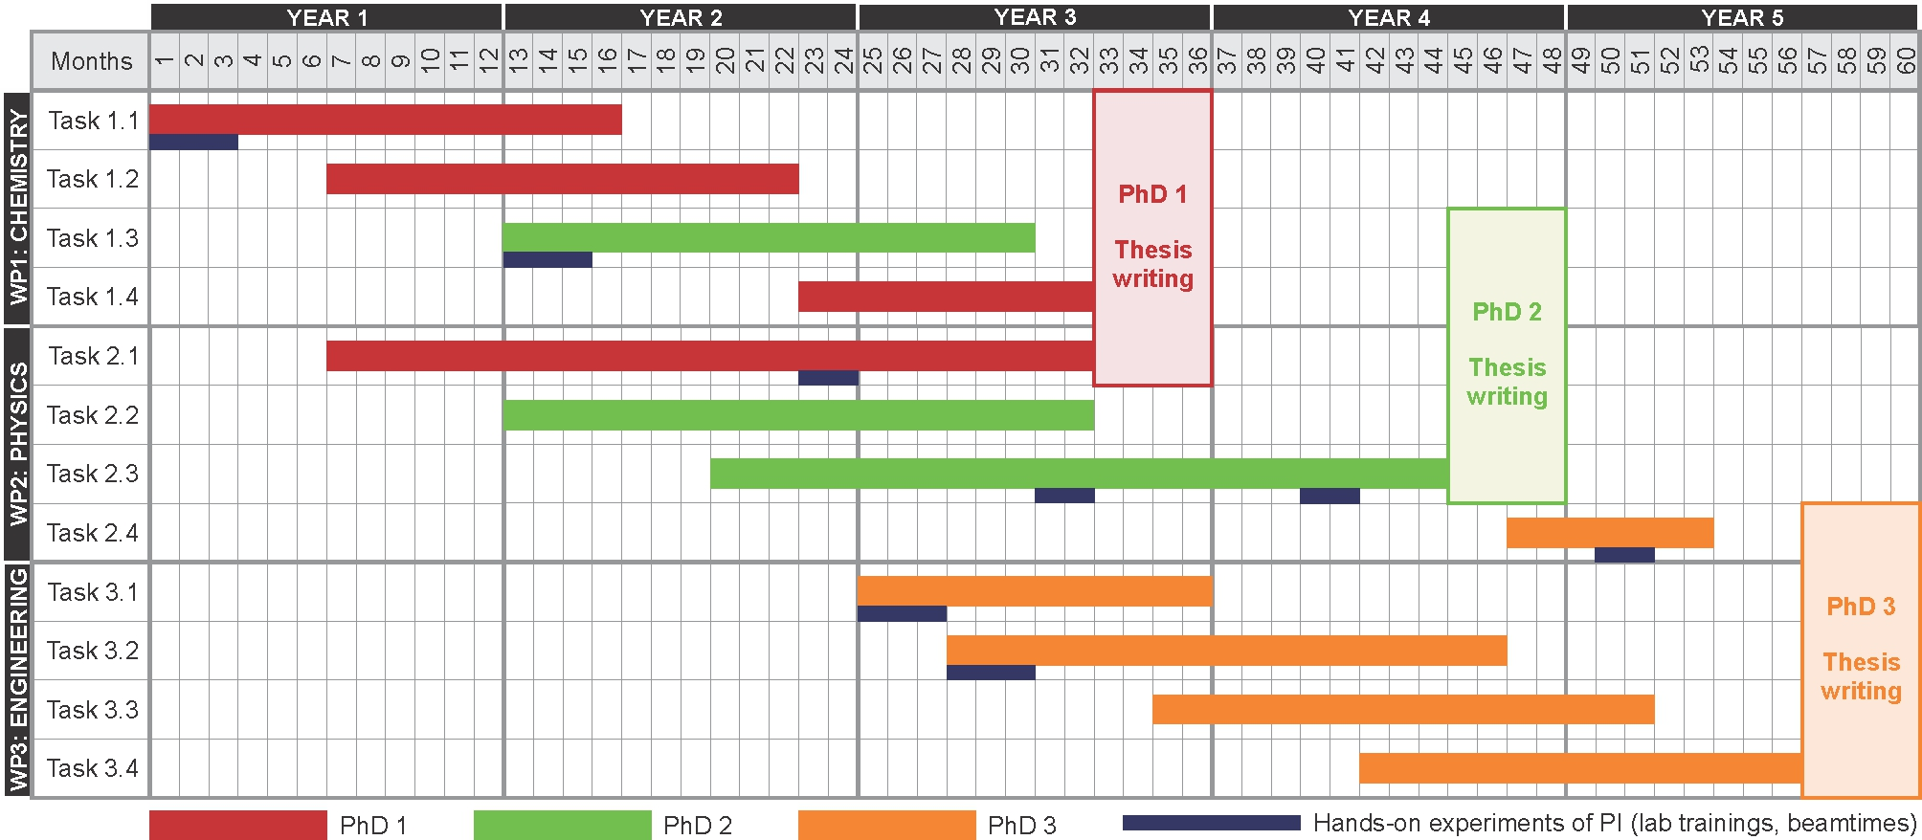
Writing a good research proposal
Example of Gantt chart
Notes:
+ Milestones
+ Deliverables

Slide 13
Writing a good research proposal
Admin part
CV
Cover letter
Motivation
Career plan
Justification of host Institute
Printouts of best publications
Budget
Reference letters
Research part
Executive summary
State-of-the-art research in the field
Methodology of your proposal
Your previous results and preliminary results
Impact and broader vision
10-40 pages
Evaluation
How novel?
How ambitious?
How feasible?
5-20 pages

Slide 14
Example: Marie-Curie Postdoctoral Fellowship
https://ec.europa.eu/research/mariecurieactions/actions/postdoctoral-fellowships

Slide 15
Writing a good research proposal
Tips and tricks: Text
Very clear structure, use headings/bullet points/tables/figures, use suggested template
Make sure that every point in the evaluation is addressed
This is technical text: each paragraph should bear a meaning (almost like a title)
Fight with text redundancy (mind a text limit)
Short sentences (think about your reader)
Make your proposal sound like must-do
Final-formatting

Slide 16
Writing a good research proposal
Tips and tricks: Methodology
As detailed as possible (given the text limit)
No secrets!
Be confident, even a little overconfident
Merge in your previous data / preliminary data
Be open about risky part, but make plan B which would sound like an equally good opportunity
Good Gantt chart, clear deadlines for milestones and deliverables

Slide 17
Writing a good research proposal
Tips and tricks: Figures

Slide 18
Getting a grant is more feasible that you think!
Enamine Ltd brings the first ERC grant to Ukraine
https://erc.europa.eu/projects-figures/project-database

